Slide 1

Machine learning for predicting used car price in Saudi arabia by: Puji Maryane (DTI-DS Student)

Slide 2

Workflow
Business Understanding
Data Understanding & Cleaning
Data Preprocessing
Data Splitting
Conclusion & Recommendation
Model Selection & Hyperparameter Tuning
Exploratory Data Analysis
Notes:
Feature importance, polinomial

Slide 3

Business problem understanding
Problem Statement:
Difficulty in determining competitive prices to optimize transactions on used car buying and selling platforms in Saudi Arabia
Goals:
Create a machine learning model that can predict the price of a used car based on its specification with a Regression approach
Metric Evaluation:
MAE
RMSE
R-Square
MAPE
Notes:
**1. Mean Absolute Error (MAE)**
- MAE is used to measure the average absolute error between the predicted value and actual value.
**2. Root Mean Squared Error (RMSE)**
- RMSE is used to measure the extent to which prediction errors are spread over the actual values.
**3. R-Squared (R2)**
- R-square is used to show how much the independent variable influences the dependent variable
**4. MAPE (Mean Absolute Percentage Error)**
- MAPE is the average of the absolute percentage errors between predicted values and actual values. It is useful to measure errors in percentage form, so they are not affected by the scale of the data.
A smaller MAE, RMSE, MAPE score indicates a higher level of accuracy. The higher the R-Squared value, the higher the level of accuracy. The R-Squared value ranges from 0-1.

Slide 4
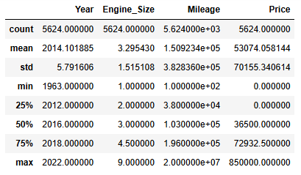
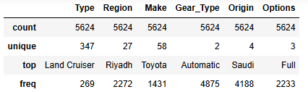
Data understanding & Data cleaning
1) Data Types
5624 Rows & 11 Columns
4 Numerical Data:
Year, Engine_Size, Mileage, Price
7 Non-Numerical Data:
Type, Region, Make, Gear_Type, Origin, Options, Negotiable
2) Statistic Descriptive

Slide 5
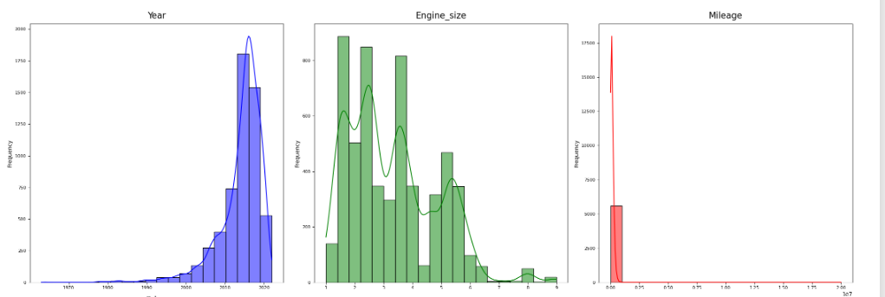
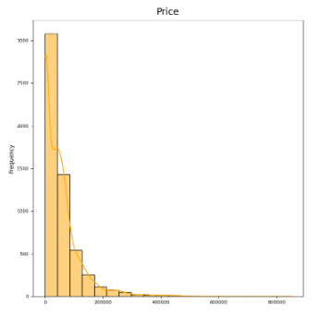
Data understanding & Data cleaning
3) Unique Values in Every Column
Type | Region | Make | Gear Type | Origin | Options | Nego | Year | Engine Size | Mileage | Price
347 | 27 | 58 | 2 | 4 | 3 | 2 | 50 | 71 | 1716 | 467
4) Duplicated Data
Number of duplicate rows: 4
Drop duplicate
5) Data Distribution
Notes:
Because these 4 data are numerical data, we can ignore the unique values ​​first and focus on the unique values ​​in categorical data.
These four numerical data show a non-normal distribution
Year: The histogram shows a left-skewed distribution, indicating that more recent years have higher frequencies.
Engine HP: The histogram displays multiple peaks and is not symmetric.
Mileage: The histogram is right-skewed, meaning lower mileage cars are more frequent in this dataset.
Price: The histogram is also right-skewed, indicating that cars with lower prices are more common.

Slide 6
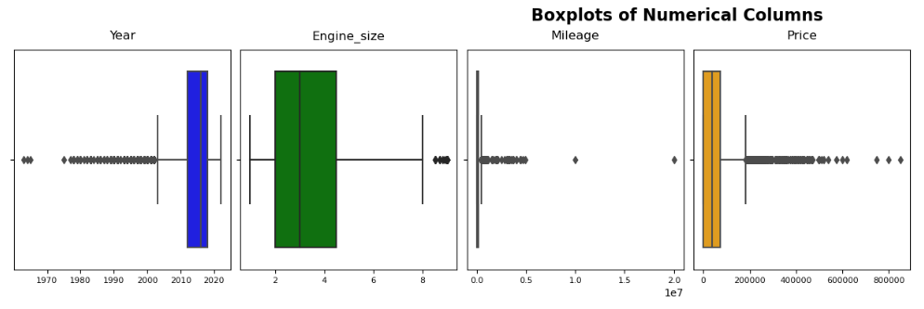
Data understanding & Data cleaning
6) Outliers
Reduce the range of outliers:
Drop year < 1970
Drop Engine_Size > 8
Drop Mileage > 9000000
Drop Price > 500000
7) Anomaly Data
Price = 0 and Price < 5000
Drop anomaly data
Notes:
The boxplots can use to identify the outliers.
Year: The boxplot shows a concentration of data around years 2000 to 2010 with some outliers before year 1990.
Engine Size: The boxplot indicates most engine sizes are between approximately 4 to almost 6 with no visible outliers.
Mileage: The boxplot displays a concentration around lower mileage values but has several outlier points at higher mileage.
Price: The boxplot shows that most car prices are concentrated around lower values but there are several outlier points at higher prices.
After I found out from several e-commerce used cars in Saudi Arabia, the price with the lower limit value was 5000 SAR (Saudi Arabian Riyals). Therefore, cars price below 5000 SAR will be delete to remove anomaly data.

Slide 7
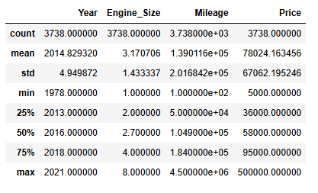
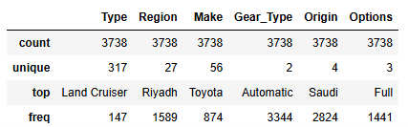
Data understanding & Data cleaning
Before Cleaning
After Cleaning
Notes:
After the cleaning process is carried out, here is a description of the statistical data. The large amount of data deleted came from an anomaly in the price column. Many data state the price is 0, which is impossible and interferes with the analysis process. Data with a price of 0 is often found in data with a negotiable yes. Therefore, the negotiable column and data rows that have a price of 0 are deleted and approximately 3 thousand rows of data remain.

Slide 8
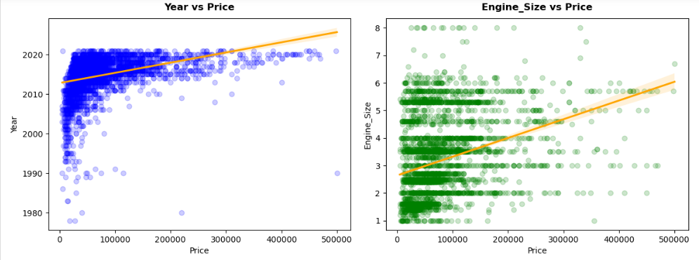
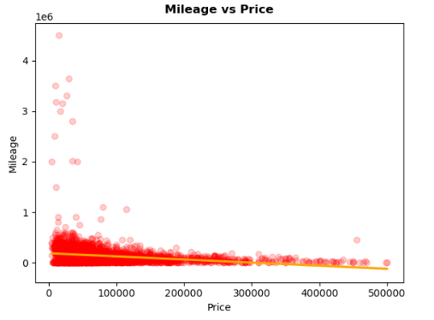
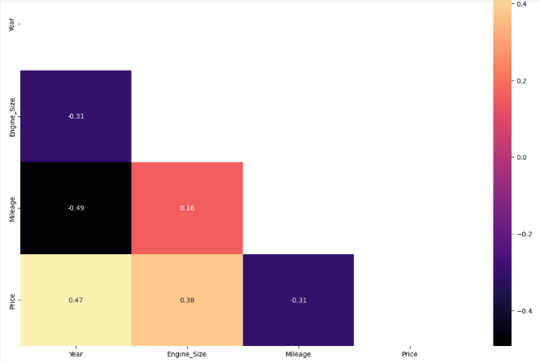
Exploratory data analysis
Notes:
This is a little bit about EDA. The correlation between year vs price, and engine_size vs price is positive. But, on the correlation between mileage vs price is negative. We can interpret that the higher of mileage it correlated with the lower price.

Slide 9
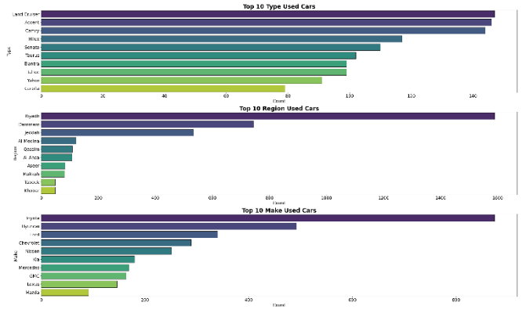
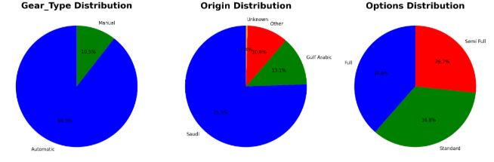
Exploratory data analysis
Notes:
After that, we also have EDA for categorical data. As we can see we have top 10 type, region, and make of Saudi arabia used car. And then, we also have the percentage of gear_type, origin, and optio distribution.

Slide 10
Data preprocessing
Column Transformer
One-Hot Encoding:
Gear_Type, Origin, Options
Binary Encoding:
Type, Region, Make
Robust Scaling:
Year, Engine_Size, Mileage
The choice of encoders and scaler is indeed based on the unique values and the nature (categorical or numerical, presence of outliers, etc.) of each column or feature.
Type | Region | Make | Gear Type | Origin | Options | Year | Engine Size | Mileage
347 | 27 | 58 | 2 | 4 | 3 | 50 | 71 | 1716
Notes:
After we do EDA, we can decide what will we do for the next.

Slide 11
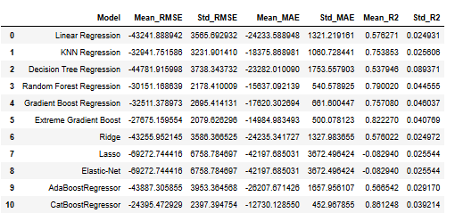
Model selection & METRICs EVALUATIOn
Linear Regression
K-Nearest Neighbors Regression
Decision Tree Regression
Random Forest Regression
Gradient Boosting Regression
XGBoost Regression
Ridge Regression
Lasso Regression
Elastic Net
AdaBoost Regression
CatBoost Regression
Notes:
After all data is ready, now we can move to the next step to choose the best model based on metric evaluation. We have 11 model candidate and we will analyze their metrics.

Slide 12
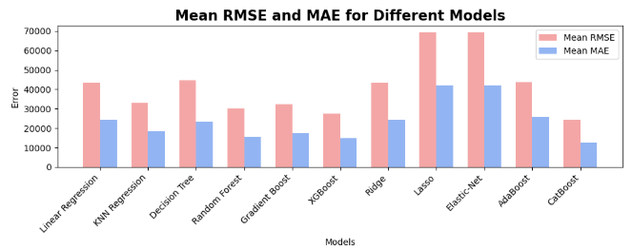
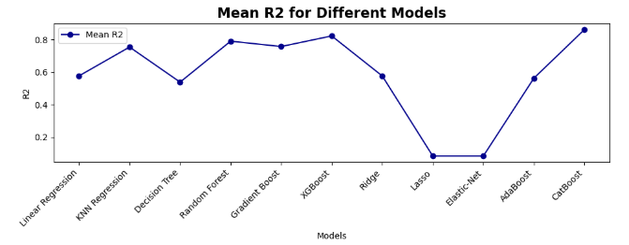
Model selection & METRICs EVALUATIOn
Notes:
To make it more easy, we can focus on this visualization. The best model has the lowest RMSE and MAE. As we can see, the lowest is Catboost. On the other hand, the best model has the highest R2, and Catboost is still has the best score. So, we can decide that we will choose Catboost for the next step.

Slide 13
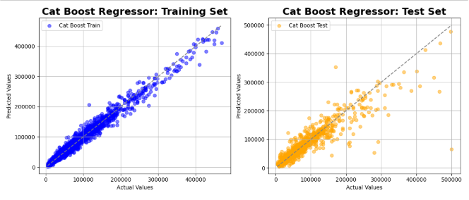


Selected model: catboost
Notes:
On this step, we devide dataset into 70% for train set and 30% for test set. Through this graphic, we can analyze that training predicted values and actual values is distributed around this diagonal line. It indicates that majority predicted values is accurate. Then we compare it with the test set whose plot is more spread out.
A better comparison of predicted and actual values ​​in the train set indicates an indication of overfitting. Therefore, hyperparameter tuning is carried out and this is the result of comparing metrics before and after tuning.
after tuning, the model performance becomes better. This is indicated by a decrease in the mae and rmse scores with mape score around 21. Apart from that, there is also an increase in r square.

Slide 14
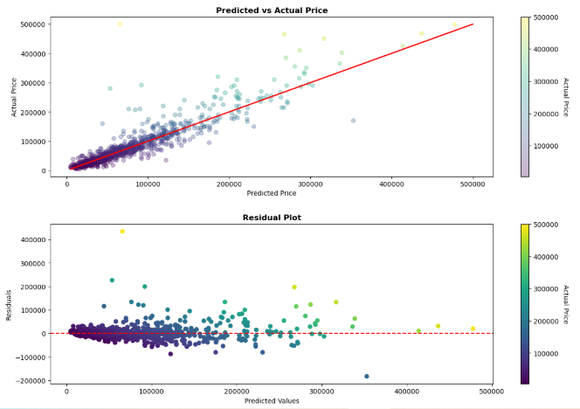
Catboost model:
Predicted vs actual price plot and residual plot
Notes:
after that, the model performance analysis is shown as well in “actual vs predicted price” graphic and residual plot.
The first plot shows that as predicted prices increase, actual prices also tend to increase with the higher accuracy in predicting is on used car prices below 100,000 SAR.
The second plot shows that most residuals are clustered around zero but spread out as we move further right along predicted values. This indicates that for lower-priced cars, predictions are relatively accurate but become increasingly volatile for higher-priced cars.

Slide 15
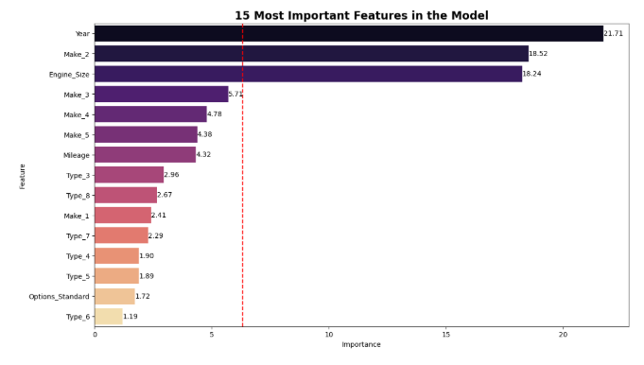
Catboost model:
Features importance
Notes:
This is the top 15 feature in the model. The most important is year with an impact of around 21.71% .

Slide 16
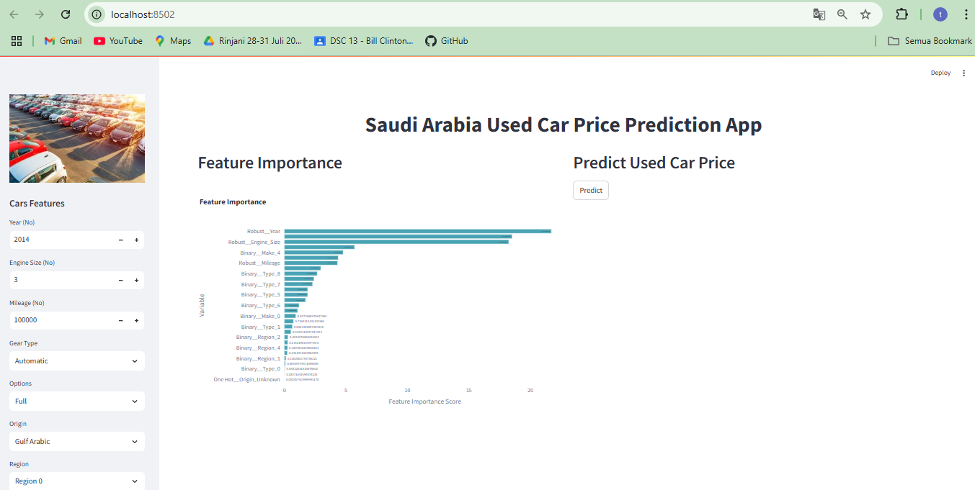
Model deployment on streamlit
Notes:
The prediction results are displayed in streamlit as in this display

Slide 17
Conclusion
After modeling is carried out for the Saudi Arabia dataset, it can be concluded that:
The best model to implement on this Dataset is CatBoost.
In comparing actual values vs. predicted results and residual plots, the higher accuracy in predicting is on used car prices below 100,000 SAR.
Through feature analysis, it was found that the most important feature in determining car prices is the year of manufacturing.
MAE | RMSE | R2 | MAPE
13445.621970 | 27653.812494 | 0.831955 | 21.226297

Slide 18
recommendation
Add data rows so that the resulting evaluation matrix does not tend to overfit.
Carefully preprocess the data to handle missing values, outliers, and skewed distributions. CatBoost is robust to these issues to some extent, but preprocessing the data appropriately can still improve model performance.
Experiment with ensemble methods that combine CatBoost models with other algorithms such as random forests or gradient boosting engines, to further improve predictive performance.
Notes:
here are some recommendations for further model development

